Slide 1


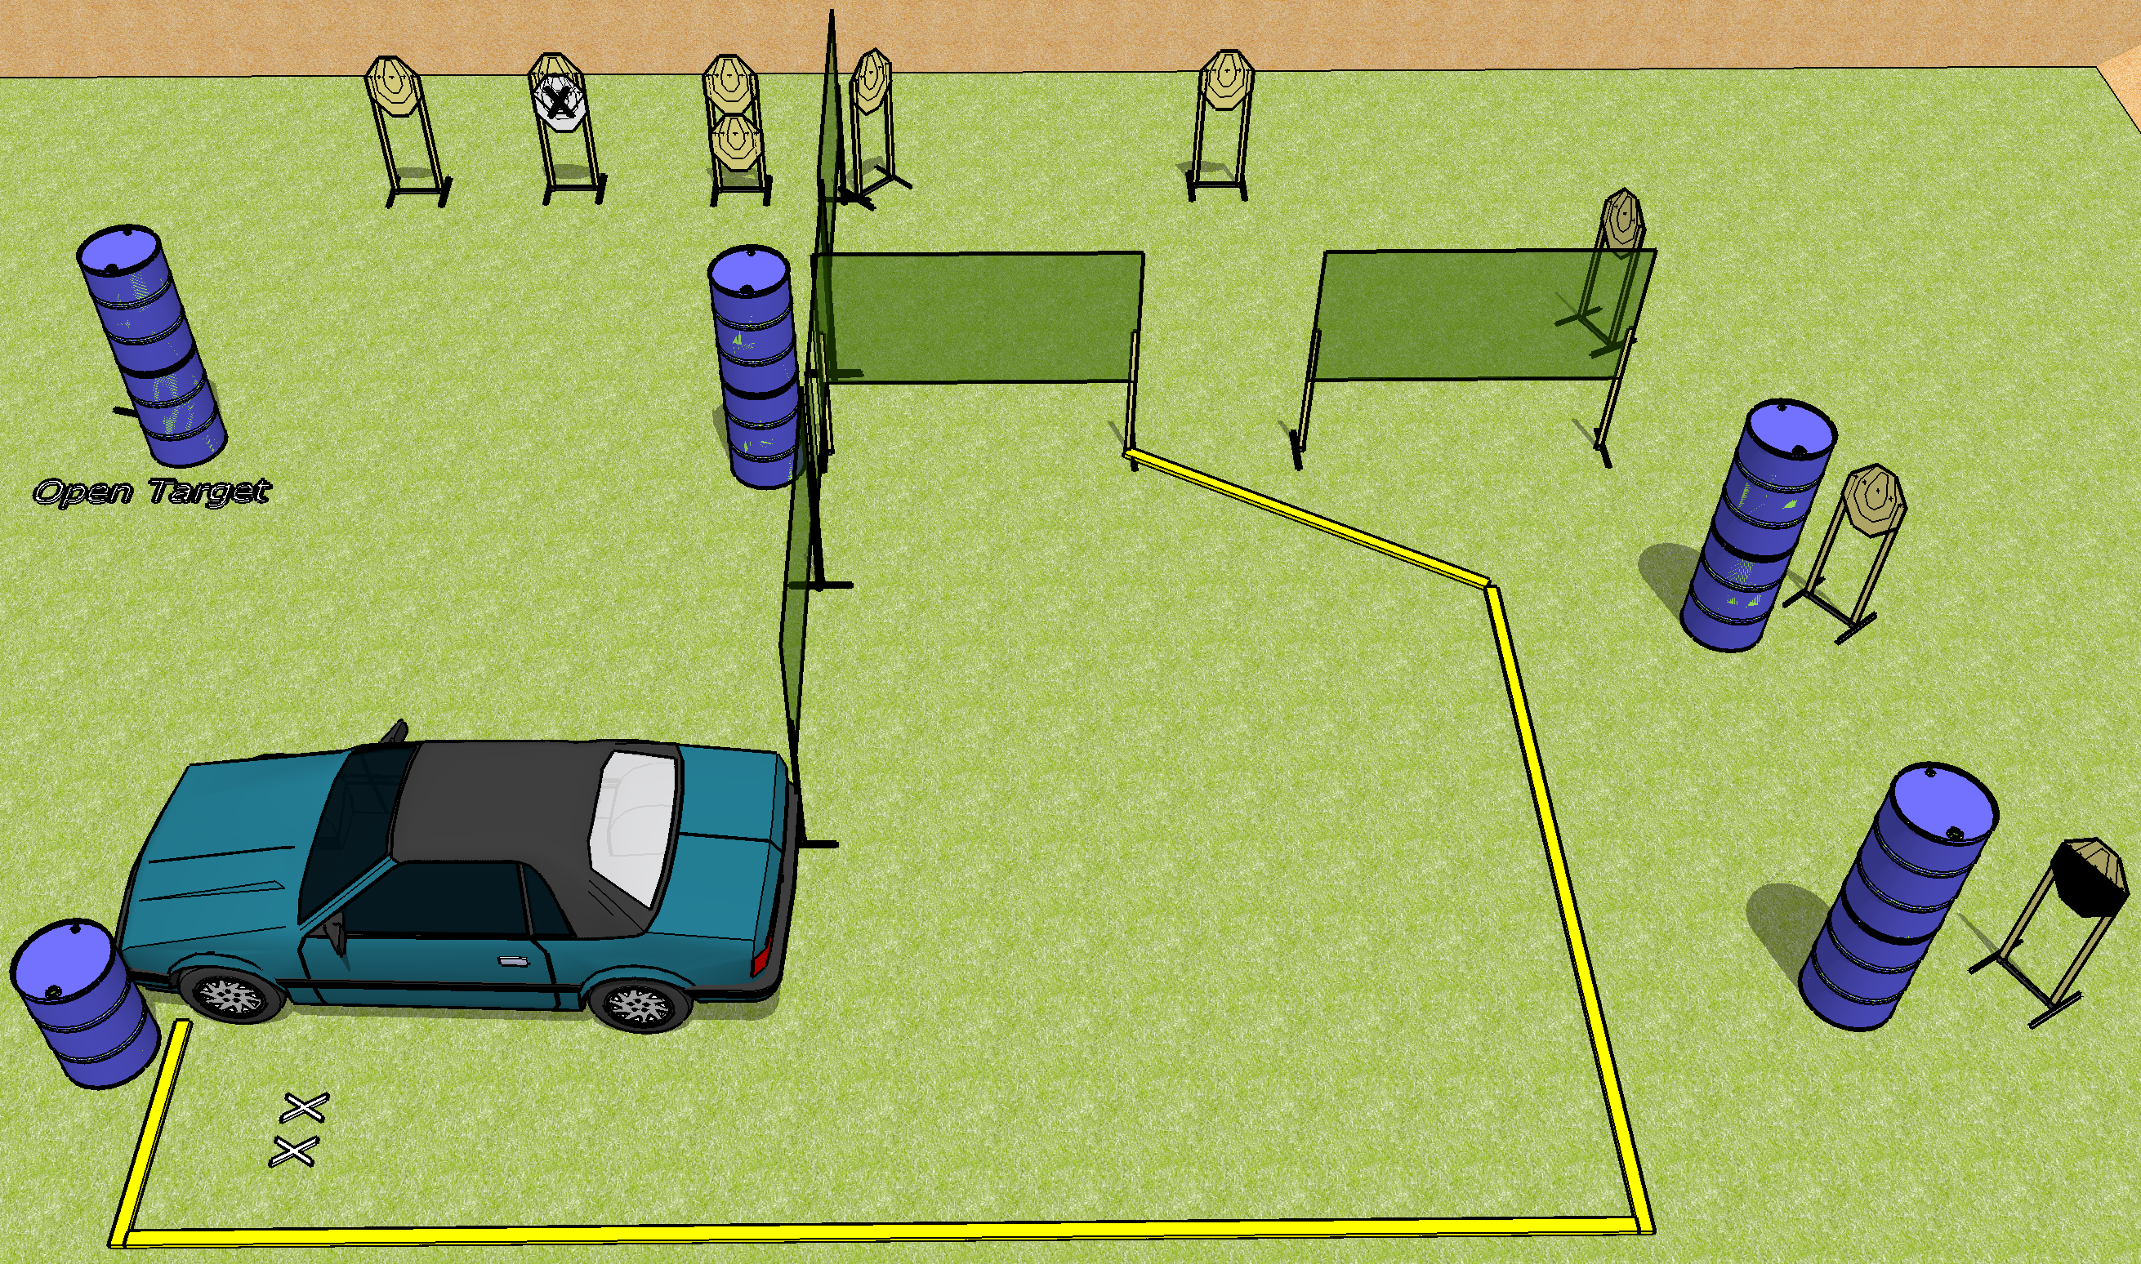
 | Dothan Gun Club – USPSA Match Oh Fu---- Course Designer : Drew Coleman
Round Count 20 rounds 10 IPSC
Equipment List Car 8 wall feet 1 half HC 1 medium fault line

Slide 2
Oh Fu----
Written Stage Briefing
Oh Fu---- is a 20 round, 100 point, Comstock course of fire. There are 10 IPSC targets. The best 2 hits on paper will score. The start signal is audible.
Handgun start position is both feet on X’s, holding hubcap in front of you. Handgun is loaded, placed on barrel.
PCC start position is both feet on X’s, holding hubcap in front of you. Carbine is loaded on barrel, safety on.
On start signal, engage targets as they become available from within the shooting area. The windows on the vehicle are ports, and must be used to engage the downrange targets.

